Slide 1
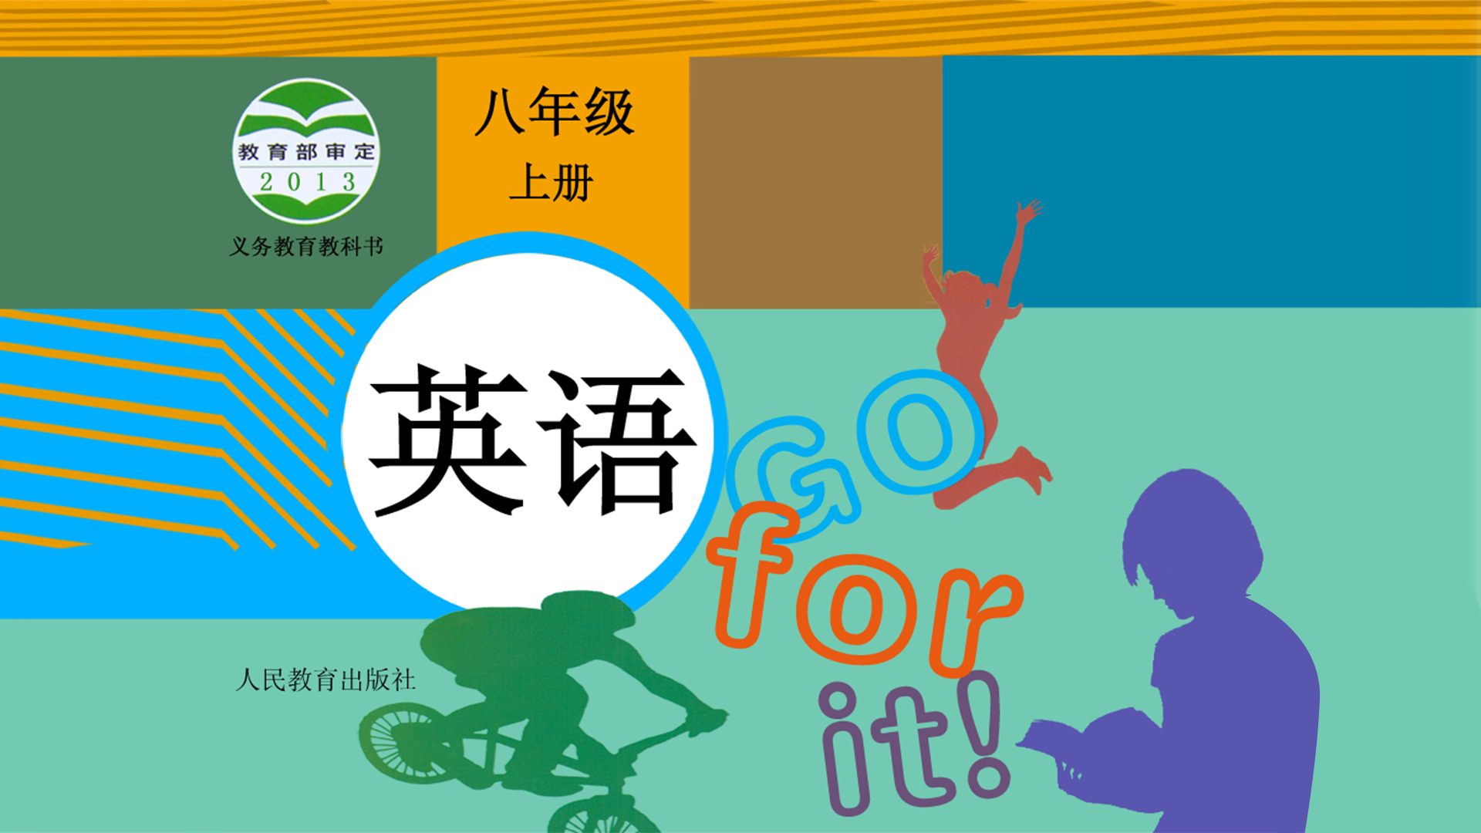
Unit 7

Slide 2
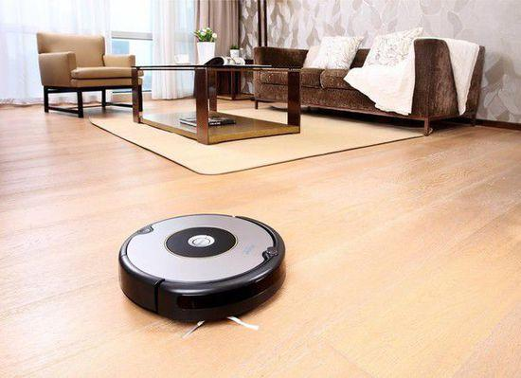
Unit 7
Will people have robots?

Slide 3
Useful Expressions
para 4: Some scientists believe that there will be more robots in the future. However, they agree it may take hundreds of years. These new robots will have many different shapes(n.形状). Some will look like humans, and others might look like animals. In India, scientists made robots that look like snakes. If buildings fall down(倒塌) with people inside, these snake robots can help look for people under the buildings. This was not possible(adj.可能的) 20 years ago, but computers and rockets also seemed impossible 100 years ago. We never know what will happen in the future.
Para. 1 Will robots think like humans in the future?
Para. 2 What will robots be like in the future?
Para. 3 What can robots do today?
Para. 4 What are robots like in movies?

Slide 4
Summary
Para. 1 What robots are like in movies.
They are usually like human servants.
Para. 2 What robots can do today.
They can work in factories, help to build cars and do simple jobs.
Para. 3 If robots will think or talk like humans in the future.
James White thinks they won’t, but many scientists thinks they will.
Para. 4 What robots will be like in the future.
There will be more robots and they will have many different shapes.

Slide 5

What can robots can do now?
cars
1. Robots can build __________ in factories.
2. They can do _________ jobs many times and never get bored.
3. Some can _________ and _________.
4. Some can help _______ people under _________.
simple
walk
dance
look for
buildings

Slide 6
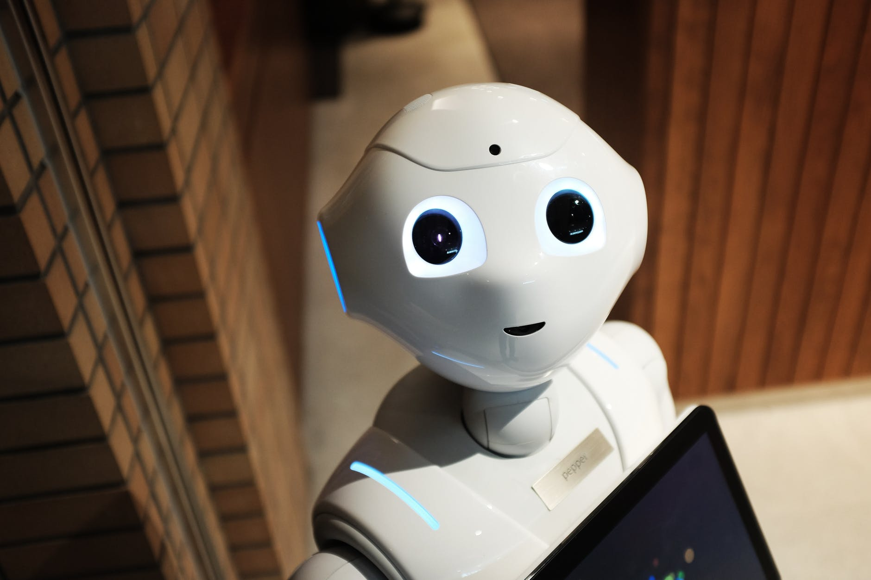


Slide 7


What kinds of animals might robots look like in the future? What do you think these robots will be able to do?
Write your ideas.
I think some future robots might look like _________. They will ____________________________________
____________________________________________.

Slide 8
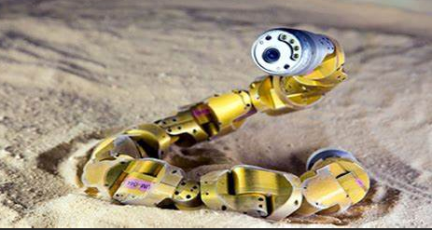
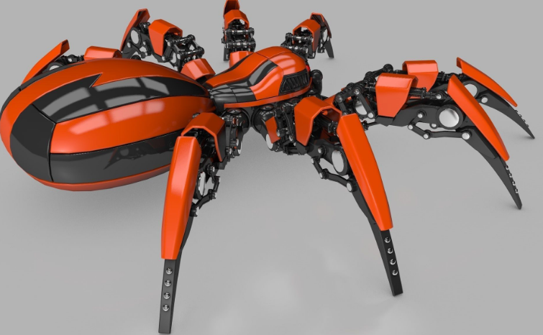
I think some future robots might look like snakes. They will be able to help look for people under the buildings if buildings fall down with people inside.
I think some future robots might look like spiders. They will be able to help humans clean the window and sweep the roof(屋顶).

Slide 9


What will your life be like in 20 years?
Let’s fill in the blanks to see Jill’s answer to the question.
meet work live look keep wear more less fewer take
In 20 years, I think I’ll be a newspaper reporter. I’ll _________ in Shanghai, because there will be _________ jobs in that city. As a reporter, I think I will _________ lots of interesting people, so I’ll have more friends. I’ll have __________ pets, though, because I’ll have __________ free time. And my apartment will be no good for pets because it’ll be too small.
live
more
meet
fewer
less

Slide 10
meet work live look keep wear more less fewer take
keep
So I’ll probably just _________ a bird. During the week, I’ll _________ smart clothes. On the weekend, I’ll _________ less smart but I’ll be more comfortable. In the future, people will _________ more so they’ll probably have fewer vacations, but I think I’ll __________ a holiday in Hong Kong when possible. One day I’ll even go to Australia.
wear
look
work
take

Slide 11
What will my life be like in 20 years?
In 20 years, I think I’ll be a newspaper reporter.
1. (job)
I’ll live in Shanghai, because there will be more jobs in that city.
2. (place to live)
As a reporter, I think I will meet lots of interesting people, so I’ll have more friends.
3. (friend)
I’ll have fewer pets, though, because I’ll have less free time. And my apartment will be no good for pets because it’ll be too small. So I’ll probably just keep a bird.
4. (pet)

Slide 12
What will my life be like in 20 years?
During the week, I’ll wear smart clothes. On the weekend, I’ll look less smart but I’ll be more comfortable.
5. (clothes)
In the future, people will work more so they’ll probably have fewer vacations, but I think I’ll take a holiday in Hong Kong when possible. One day I’ll even go to Australia.
6. (holiday)
7. transportation
8. environment
9. neighborhood
10. free time activities

Slide 13



Write about your life 20 years from now. Use 3a and notebook to help you.
_____________________________________________
_____________________________________________
_____________________________________________

Slide 14



1. Put the words in the correct columns in the chart.
job, people, pollution, robot, fresh water, paper, planet, car, clean air, city, free time, building, money, tree
more/fewer | more/less
more+可数名词/不可数名词
fewer+可数名词
less+不可数名词

Slide 15
job, people, pollution, robot, fresh water, paper, planet, car, clean air, city, free time, building, money, tree
more/fewer | more/less
job, people,
robot, planet
car, city
building, tree
pollution, fresh water
paper, clean air,
free time, money

Slide 16
2. Fill in the blanks in the conversation.
Girl: Mom, what will the future ____ like?
Mom: Well, no one knows what the future will be _____.
Girl: But _____ I be beautiful like you? _____ I be a pilot? I want to fly up into the sky.
be
like
will
Will
Mom: You’re already beautiful. And you should study hard. Then you _____ be a pilot.
Girl: OK. I must study harder then.
Mom: But you should also remember that ______ will ______ both good and bad things in life.
Girl: Oh, but I’m not scared, Mom, because you _____ help me!
can
there
be
will

Slide 18



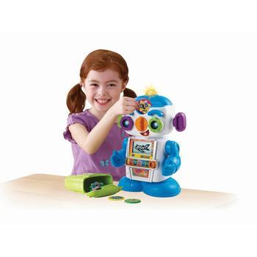
Discuss how you think a robot will help students with schoolwork in the future. Write down your group’s ideas and draw a picture of your robot.
I think students won’t need dictionaries because a robot will tell them the meanings of the words.

Slide 19
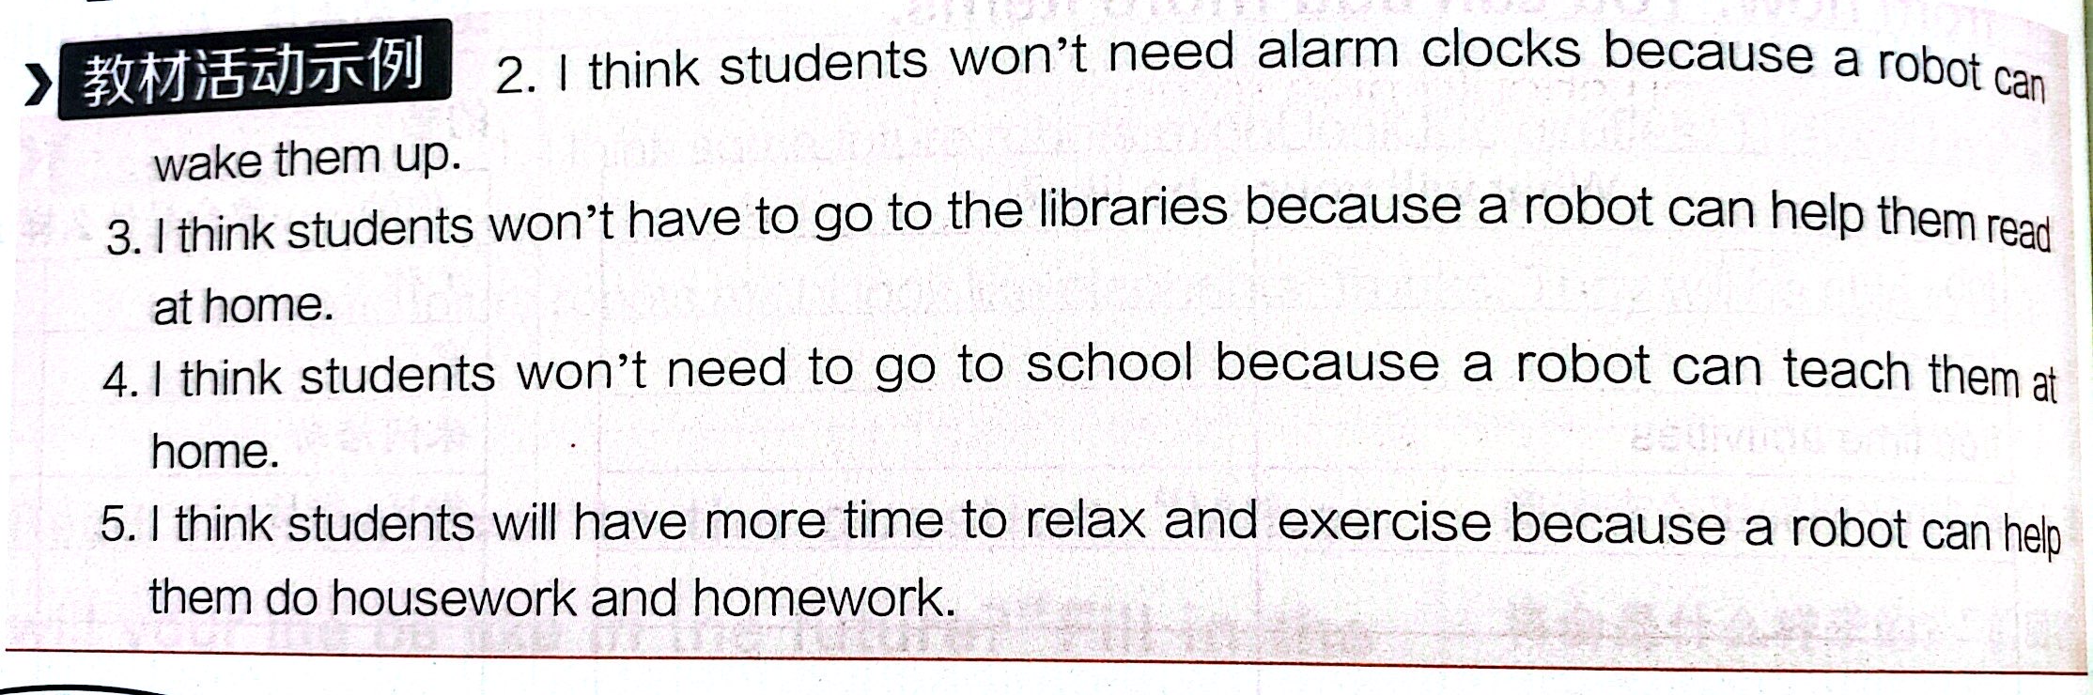

Slide 20

Complete the chart about your life 20 years from now. You can add more items.
What will my life be like in 20 years?
job
home/place to live
free time activities
neighborhood

Slide 21
Complete the chart about your life 20 years from now. You can add more items.
What will my life be like in 20 years?
job
home/place to live
free time activities
neighborhood
transportation
friends
pets

Slide 22
What will my life be like in 20 years?
job | teacher, scientist, doctor, bus driver, cook, engineer, pilot, actor, pianist, violinist, computer programmer, basketball player, astronaut...... I think I will be a .../ I’m going to be a ...

Slide 23
What will my life be like in 20 years?
place to live/ home | look for another planet to live on, build more space stations, build houses under the sea, live on the moon The homes of the future will have robot servants. Smaller and more environmentally friendly houses will be more popular. Cities will be more crowded.

Slide 24
What will my life be like in 20 years?
Free time activities | go to the moon for a holiday People will have much more free time / have more holidays / have talking animal friends ... Cinemas will show 3D movies with real people.

Slide 25
What will my life be like in 20 years?
neighborhood

Slide 26
What will my life be like in 20 years?
Transportation | car (run on new and clean fuels (燃料) or self-driving) Cars and buses will fly around the city. People will have their own planes. Most people will use space rockets (they will fly from one side of the planet to another in an hour).

Slide 27
What will my life be like in 20 years?
Environment P50 P51 | short of water, air pollution, less clean air (people have to pay for clean air), fewer trees, more buildings The weather will be much hotter / worse... There will be more / fewer people / cars / trees...

Slide 28
What will my life be like in 20 years?
Other aspects | live to be over 150 years old, work at most three days a week, work from home People will get along well with robots (see robots everywhere). Students will study online. Students won’t have to go to school. E-books will replace (取代) traditional books. Money will be less important. Everything will be free.

Slide 30



To finish Jill’s predictions about her life in 20 years.
To learn to write about your life 20 years from now.
To finish Self Check.

Slide 31


Fill in the blanks with the right words.
already
Today there are ________ robots working in ________. For example, they can help to ________ cars, and they do ________ jobs over and over again. They do jobs like working in dirty or __________ ________. Fewer people will do such jobs in the future because they are boring, but robots will never get _______. Some scientists _______ that there will be more robots in __________ ______ years. They are trying to make robots look like ________.
factories
build
simple
dangerous places
bored
believe
hundreds
of
humans

Slide 32


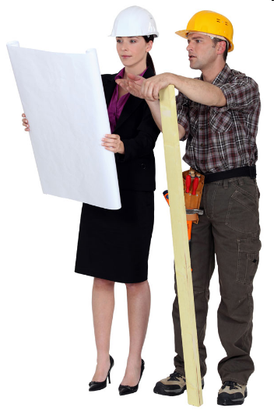
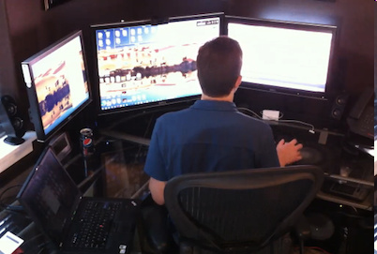
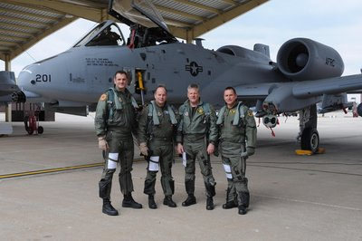
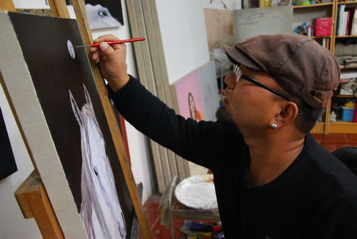
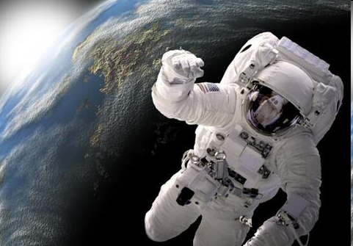
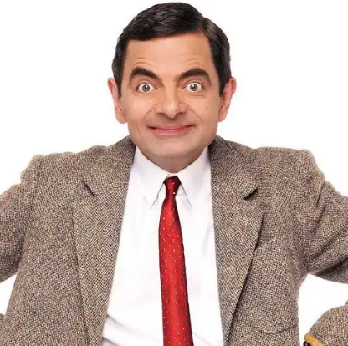
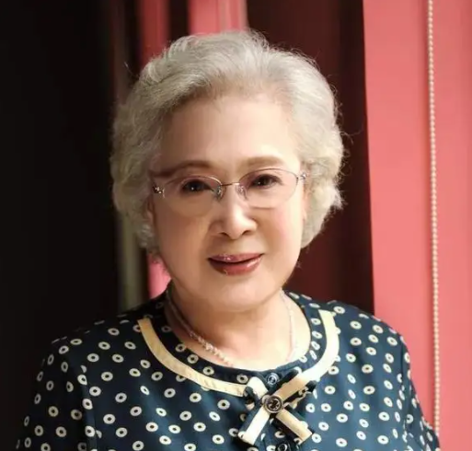
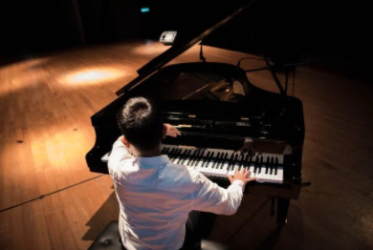
What will you be when you grow up?
computer
programmer
pilot
engineer
artist
astronaut
actor
actress
pianist

Slide 33
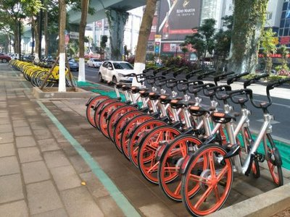
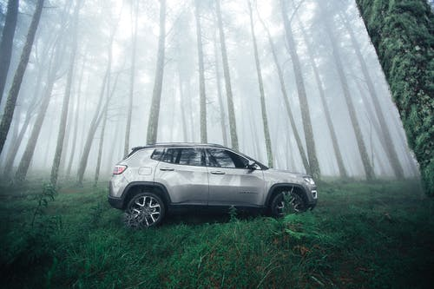
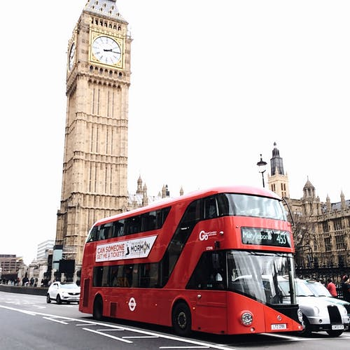
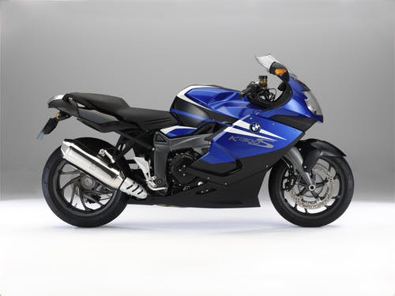
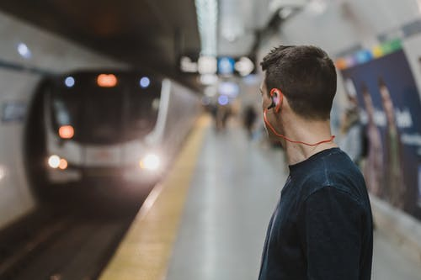
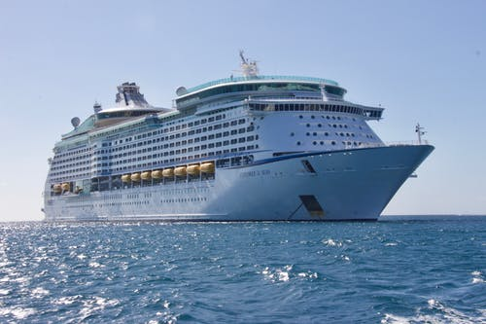
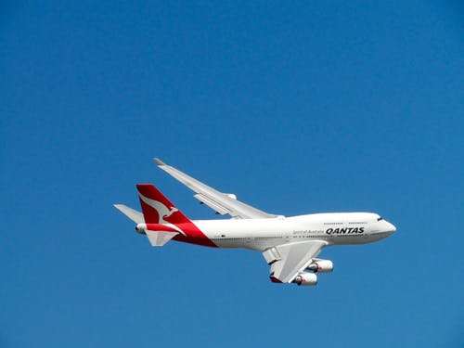
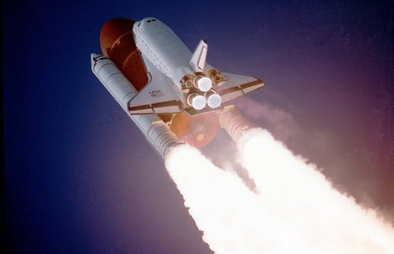
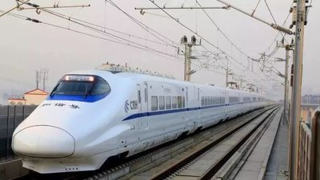
How will you go to work in the future?
bike
car
bus
subway
ship
motorbike
rocket
plane
train

Slide 34
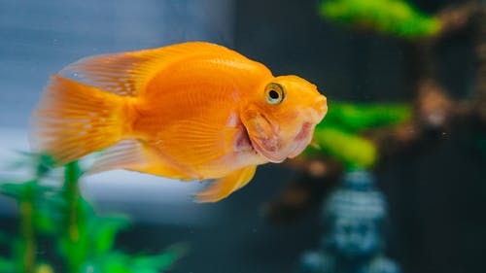
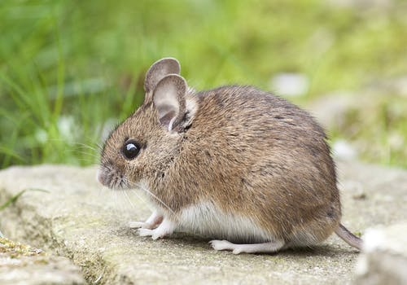
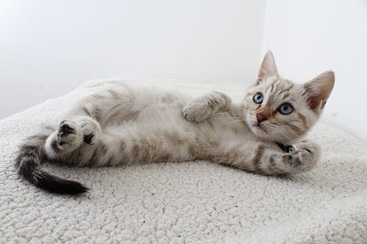
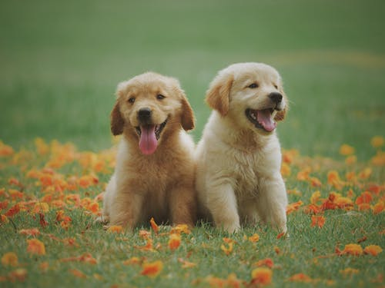
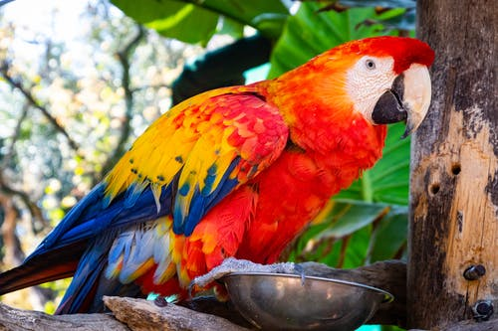
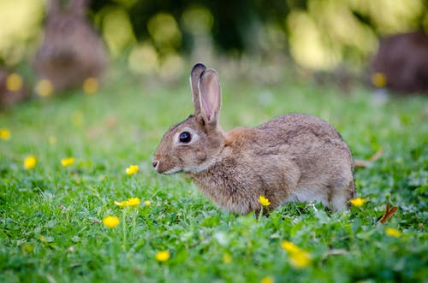
What kind of pets will you keep?
goldfish
mouse
cat
dog
parrot
rabbit

Slide 35

Read Jill’s answer to the question “What will your life be like in the future?” Fill in the blanks with the words in the box.
meet work live look keep wear more less fewer take
阅读方框中的单词，明白单词意思；阅读并整体把握短文大意。
分析有空格的每个句子，根据句意及上下文来判断每个空格应填的词。
通读短文，看是否通顺合理。

Slide 36
解析
1. live: 由下文“在那座城市里有更多的工作”，可知本空填live“居住”一词。
2. more: 空格前是be动词，空格后为jobs名词，可知前面应有形容词来修饰，由句意可知应填more （大都市就业机会多）。
3. meet: 空格前为情态动词will，空格后为名词people，本空应填动词meet (遇到)。作为一名记者，我想我将会遇到很多有趣的人。
4. fewer: 下文“并且我的公寓将会对养宠物没好处因为它太小了。”，可知我将有“更少的”宠物，故本空填fewer。

Slide 37
5. less: 由下文“不适合养宠物”且空格后的free time是不可数名词，可知空格处应用less一词。
6. keep: 上文描述的是养宠物的事，因此应填keep“养”之意。
7. wear: 空格后有名词clothes，空格处应为动词wear“穿”。
8. look: 空格前是主语I’ll，空格后为形容词smart，故为系动词look。
9. work: 由下文“因此他们将可能有更少假期”，可知本空填work“工作”一词。
10. take: take a holiday为固定搭配，“有可能的话，我会在香港度假。”

Slide 38
You have read Jill’s predictions about her life in 20 years. Now fill in the blanks.
What will Jill’s life be like in 20 years?
job
places to live
friends and pets
dressing
free time activities
reporter
Shanghai
more friends, less pets
smart clothes, comfortable clothes
take holidays

Slide 39

本文为写自己未来二十年后的工作及生活，时态应用一般将来时态。
首先，根据3b表格中的内容，想像一下自己的生活。工作、家庭、业余活动，生活环境等。
将上述几方面写出来，注意恰当运用连接词，以使文章连贯通顺。
最后通读短文，检查是否有错误。

Slide 40


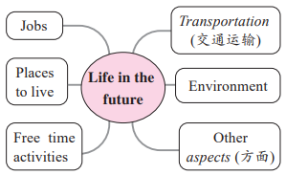

Slide 41
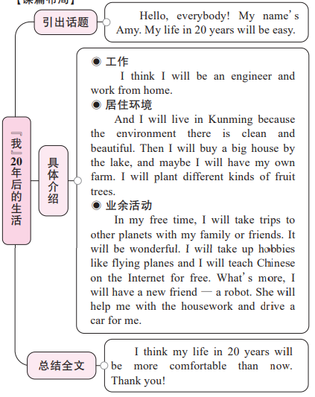

【谋篇布局】

Slide 42
【点评】
1. 内容：本文的作者充分发挥了想象力，将自己20年后的生活清晰地展示到读者眼前，从工作、居住环境、业余活动三方面进行畅想，井然有序；且不是泛泛而谈，而是有细节支撑。比如在介绍未来居住的地方是昆明时，不是单薄地只说个地名，而是给出了理由，使短文的内容丰富饱满。
2. 语言：本文在描述自己20年后的生活时多次用到句型I will ...，这种结构的重复使用可以使文章连贯。另外，本文从不同角度畅想未来生活，用and, then, what’s more等表示语义增进，以使行文过渡自然、流畅。最后一段运用了比较级句型，总结全文，表达了对未来美好生活的憧憬。

Slide 43

In 20 years, I think I'll be a teacher. I'll live in Xi'an, because it's a wonderful city. Lots of people from China and other countries visit that city, so I'll meet lots of interesting people. I'll live in an apartment near my school so I don't have to travel much. I may have more free time, so I'll spend more time with my friends. I'll see them on the weekend and we'll play soccer every Saturday. We'll also do some other interesting activities together, such as hiking in the national parks.

Slide 44
解析
1. be: like介词，像，因此本句中缺少be动词，句中有情态动词will，应用be动词的原形。
2. like: 没有人知道将来会是怎么样？本句缺少介词，用like。
3. will, Will: 我会像你一样漂亮吗？我会成为一名飞行员吗？用一般将来时。
4. can: 空格后是be动词原形，应用情态动词can，能够。
5. there, be: 但是你应当明白生活中既有好的也会有坏的事情，there be句型的一般将来时态。
6. will: 因为你将会帮助我。一般将来时态。

Slide 45


robot, free time, country, peace, school, money, computer
Jobs
Other aspects
astronaut, scientist, computer programmer
Life in the future
Environment
planet, earth, sea, sky, tree, pollution, city, water, fresh air, building
Places to live
Transportation
house, apartment, space station
train, rocket, car, subway

Slide 46
Life in the future
Structures
Predictions
A: What will the future be like?
B: Cities will be more polluted. And there will be fewer trees.
A: Will people use money in 100 years?
B: No, they won’t. Everything will be free.
A: Will there be world peace?
B: Yes, I hope so.
Kids will study at home on computers. They won’t go to school.
more/fewer:
job, people, robot, planet, car, city, building, tree
more/less:
pollution, fresh water, paper, clean air, free time, money

Slide 47


根据短文内容从方框中选择恰当词语填空，有的需要变换形式。
earth, danger, planet, during, rocket, plant, possible, agree, build, believe
On May 30, 2020, a private (私人的) American company (公司) named SpaceX succeeded (成功) in sending two astronauts into space by using its own (1)_______. This is the first time in history that a private company has sent astronauts into space. So let’s spend some time learning about the founder (创办者) of this company. It is Elon Musk.
rocket

Slide 48
earth, danger, planet, during, rocket, plant, possible, agree, build, believe
He was born (出生) in South Africa in 1971. When he was 17, he moved to Canada. Four years later, he went to study at a famous university in the USA. (2)_______ his study at university, he became interested in space. He dreamed of living on Mars (火星), another (3)_______ in our solar system (太阳系). To him, nothing was more exciting than living on Mars. To make his dream come true, he worked hard to make money after university. By June 2002, he had already made enough money to set up his own company SpaceX.
During
planet

Slide 49
earth, danger, planet, during, rocket, plant, possible, agree, build, believe
believes
Elon Musk (4)_________ that humans will live on Mars in the future. Now he is planning (5)_________ a city on Mars. In the city, people will be able to (6)_________ trees and grow vegetables. However, many people (7)_________ with him. They think that it is (8)_________ for humans to live on Mars, because it is too far away from (9)_________. Some people even think it may be (10)_________ to live on Mars because it is too cold there.
to build
plant
disagree
impossible
earth
dangerous

Slide 50


Finish your writing about your life 20 years from now. If you have finished writing in class, do make some improvements.
List the new words and expressions of this unit.

Slide 51


